Slide 1
WV Public Energy Authority LNG Export August 22, 2012

Slide 2
Natural Gas Spot Prices
Monthly Average 1997-2012
(Dollars per Million BTUs)
Marcellus Shale Gas Production Lowers Price
Demand up 6.5 BCFD
Source: Energy Information Administration, Henry Hub Natural Gas Spot Price.
Notes:
As you know, natural gas prices have historically been volatile.
In the electric utility sector, the main argument against natural gas generation was future commodity risk.
As a result of the shale gas revolution, we have enjoyed a three-year period of increasingly low natural gas prices,.
Most long-term forecasts anticipate historically low natural gas prices for the long-term.
The most dangerous words in either investing or utilities are “this time it is different.” Certainly some of today’s very low natural gas prices reflect a warm winter and a relatively weak economy.
However, the underlying supply metrics are consistent with a forecast of long-term low natural gas prices.
Simply put, we’ve got tremendous reserves of natural gas and we’re getting increasingly good and cost effective at getting it to market.

Slide 3
Support for Cove Point Project
The Post’s View
Cove Point means business
“The opportunity here is obvious: The United States should export some of its bountiful stocks of natural gas to Japan and other countries with fewer supplies and high demand. That is why Dominion Resources wants to retrofit its Cove Point facility to service exports as well as imports.”
“In fact, with the Interior Department and the Environmental Protection Agency both out with sensible new rules over the past few weeks, approving projects such as Cove Point should be seen as a win for everyone, environmentalists included.”

Slide 4
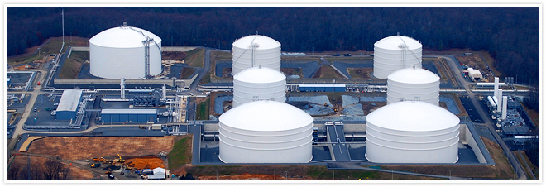
Cove Point Export Project Benefits for the United States
Jobs
7,000 Short Term
14,600 Long Term
U.S. Trade Imbalance
Reduce $2.8 to
$7.1 billion/year
0.6% to 1.4% improvement
Taxes
Almost $1.0 billion
per year
Up to $40 million in annual property taxes in Calvert County, MD
Revenue
$22 billion in government royalty revenue
Source: ICF International
Notes:
Specifically, economic studies filed with the application show benefits from exports and upstream gas production over the 25-year proposed term could include:
A reduction of the U.S. trade imbalance by at least $2.8 billion annually, and possibly as much as $7.1 billion;
A total of $22 billion in added government royalty and other revenues to federal, state, and local governments over the 23-year post-construction operating period (2018-2040), an average of $962 million annually. In addition, there would be $9.8 billion in landowner royalty income over the 25-year operating period;
Up to a $40 million annual increase in local property tax revenues in Calvert County Maryland; and
About 14,600 permanent jobs during the 23-year post-construction operating period (2018-2040), which are associated with facility operations and upstream natural gas production.
Nationally, could add more than 7,000 short-term jobs during peak of construction and approximately 14,600 permanent oil and gas industry jobs once in operation.

Slide 5
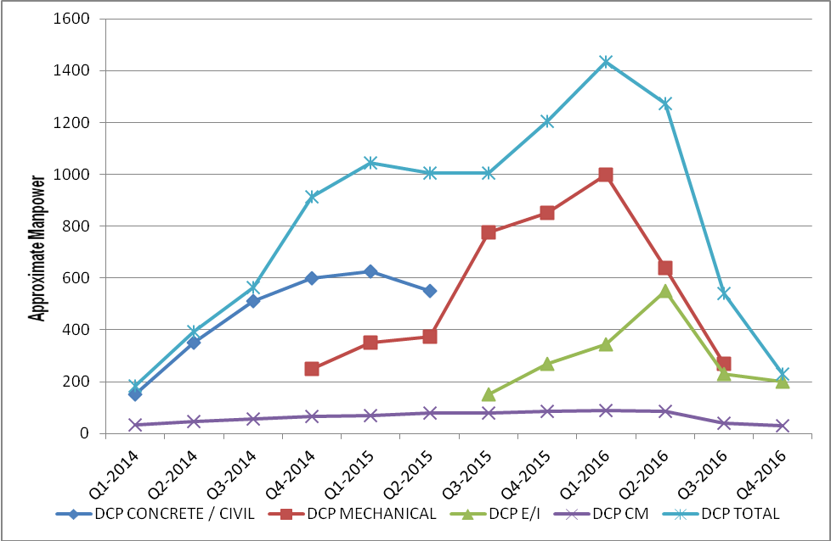
Cove Point Export Project Construction Jobs
Approximately 5-6M total man-hours
1,500 jobs on-site at the peak of construction
750 jobs on average through the 36-42 month construction period
Source: Dominion Estimates

Slide 6
Domestic Shale Production Forecast
Expected to reach
11.1 Bcf/d in 2020
5.6 BCFD
Source: Wood Mackenzie

